Slide 1
AI & The Future of Learning

Slide 2
Collective
Augmented Intelligence
Immortal Teachers
Personal
Pensieve
Dementia Guide
Effective
Pace & Coverage
Sparring Buddy

Slide 3
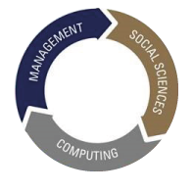
On SMU
Young university (Established 2000)
420+ faculty (2/3 tenure + 1/3 term track)
Focused on how human societies organise well, including in successful scaling of new tech
Legal and regulatory systems, financial systems, urban systems, business models, economic and incentive structures, individual and societal psychology, and our digital and information infrastructure and its interfaces with humans
BUSINESS
LAW
STUDIES
INTEGRATIVE
ACCOUNTING
SOCIAL
SCIENCES
COMPUTING &
INFORMATION
SYSTEMS
ECONOMICS
Digital Transformation
Sustainable Living
Growth in Asia
Transformative
Education
Cutting Edge
Research
Engaged
City University

Slide 4
Can AI Situated Agents Help Scale Interactive Adult Learning?
Presented by
Archan Misra

Slide 5
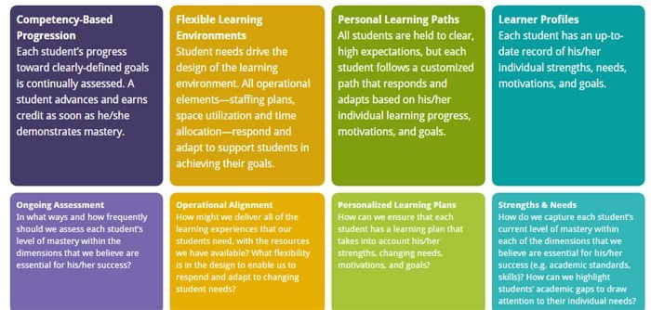
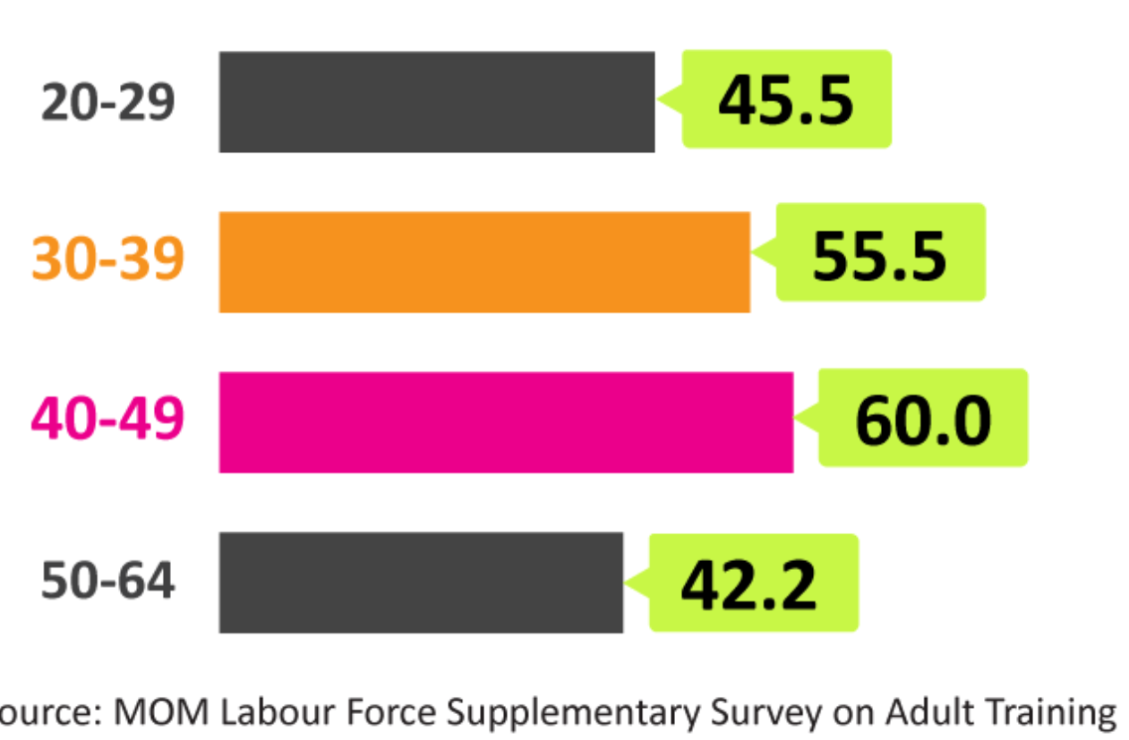
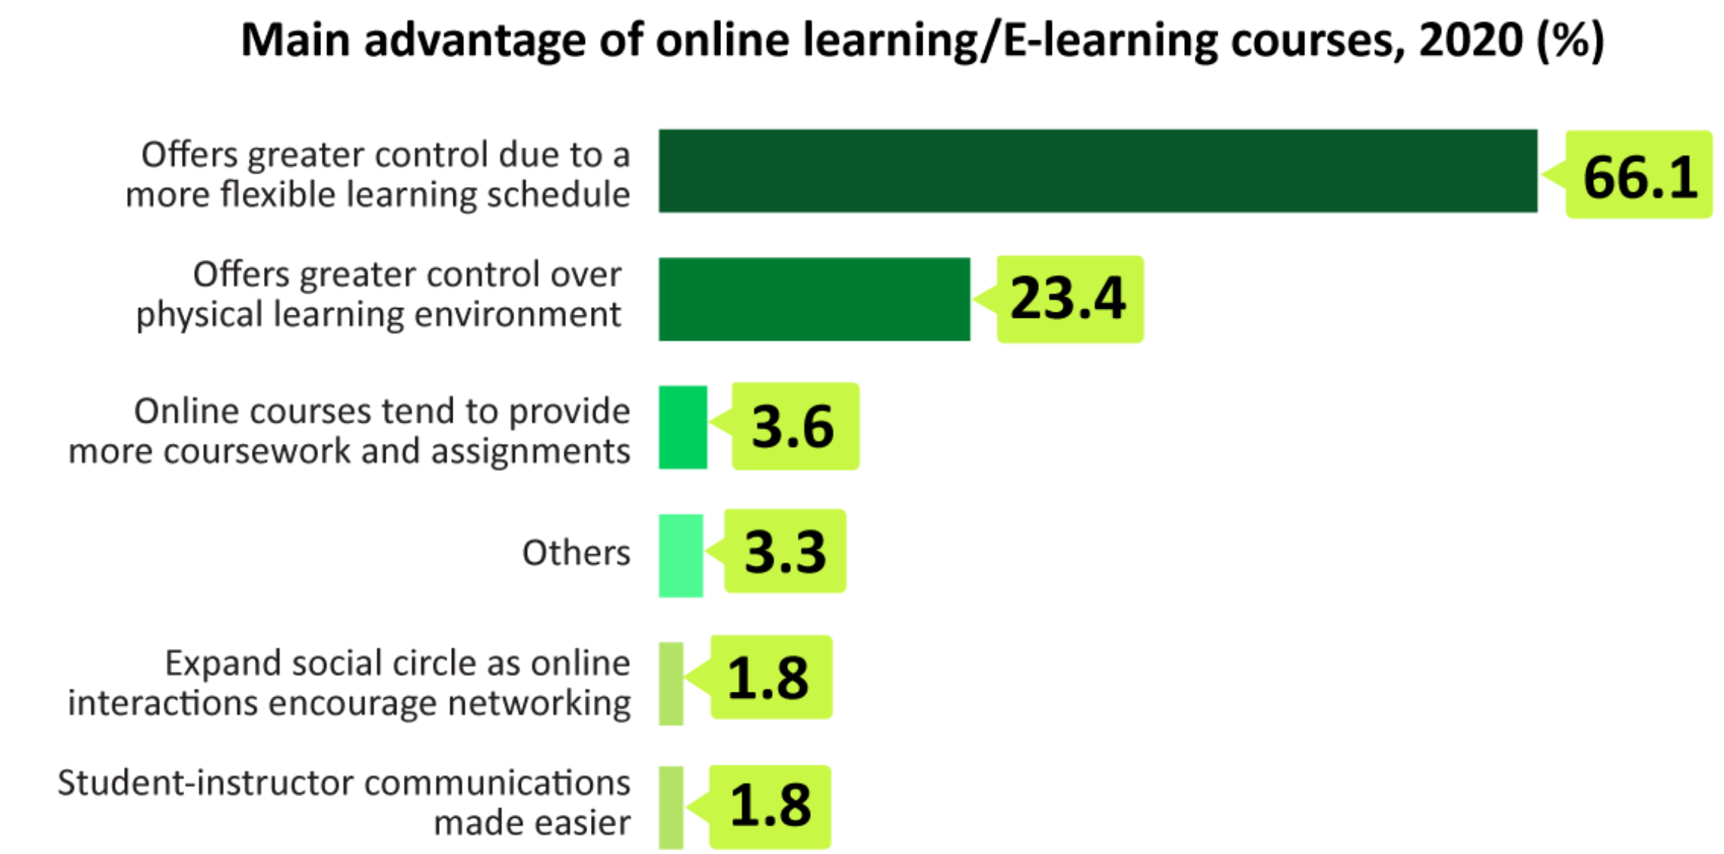
Adult Learning: Key Challenges from my Perspective
Adult Learning is More Prevalent than we assume
Key Challenges in Adult Learning
Irregular schedules: distractions from professional and family commitments
Wide variation in skills, motivation and neuroplasticity
Preserve interactivity while scaling up
41.3% of the respondents found a lack of social interaction found in a physical classroom environment to be the main drawback of online learning.
Goal: Mass Personalisation
Notes:
There is always a random error in every frame. Hence, we can observe a variation in the standard deviation even for a single camera in a static environment.

Slide 6
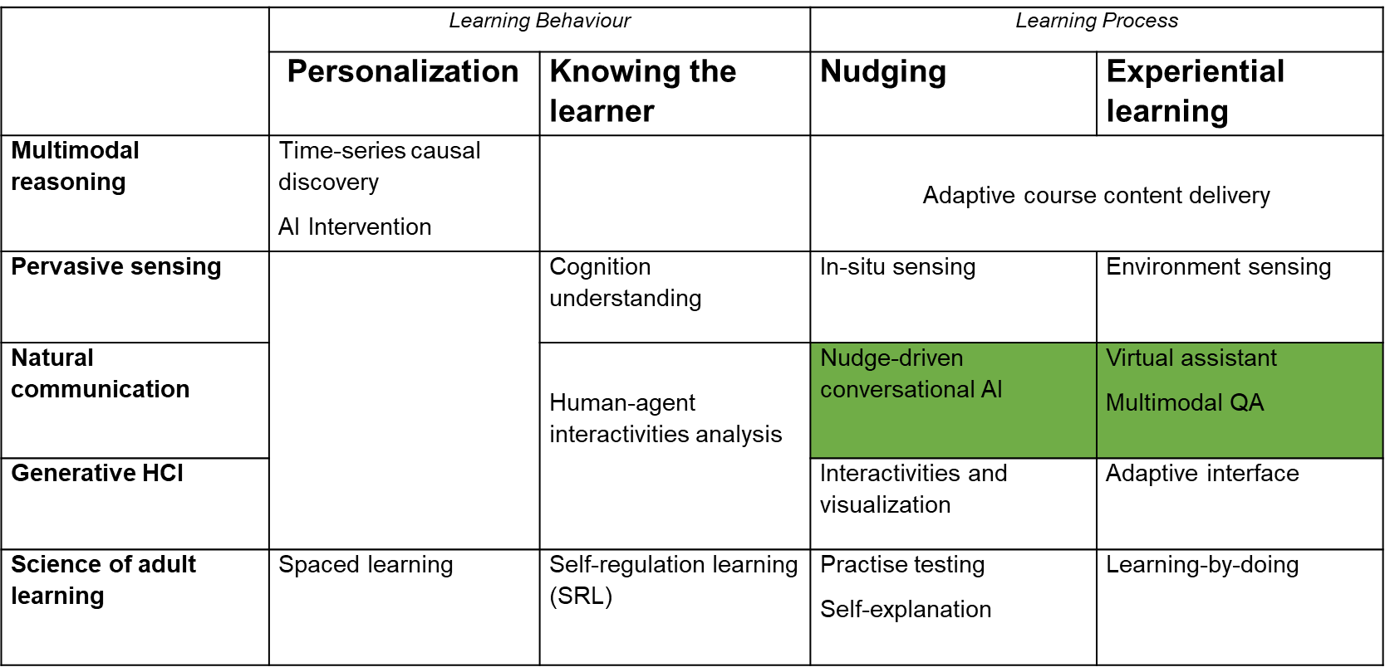
Adult Learning: Mass Personalization Components
DeepTech for Adult Learning
Learner Focus
Technology Focus
Self-regulated learning
Seamless learning
Behaviour prediction & monitoring
GAI Scaffold
Notes:
There is always a random error in every frame. Hence, we can observe a variation in the standard deviation even for a single camera in a static environment.

Slide 7
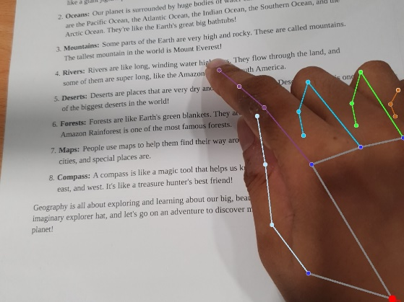
T4: Online Interactive Agents ….Ongoing Work
Goal: Develop technology whereby an AI-enhanced situated learning bot can comprehend multi-modal query from learner
Multi-modal Q&A conversational bot
Remote Learning: System Architecture
Novel technical features:
LIDAR-based sensing to capture fine-grained hand gestures
Enhanced VLM to support situated dialog (3D memory)
Short demo of system (under development)
Output of the gesture key-point detector
Notes:
There is always a random error in every frame. Hence, we can observe a variation in the standard deviation even for a single camera in a static environment.

Slide 8
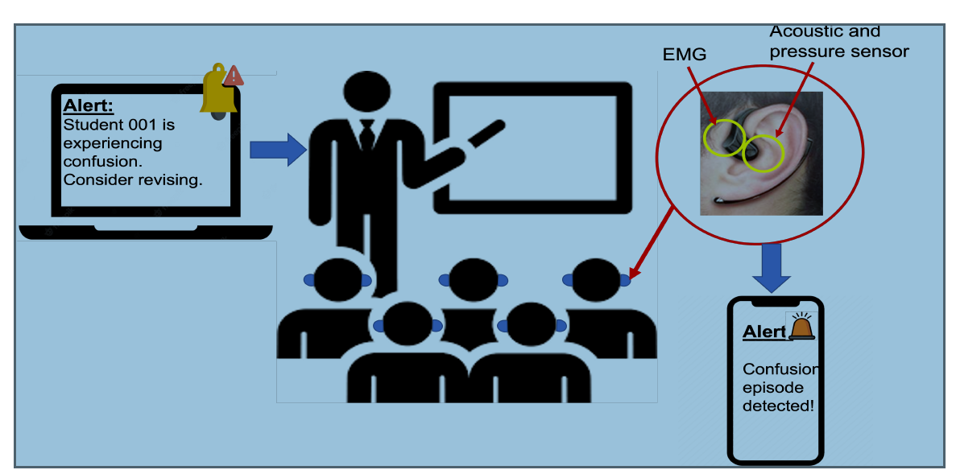
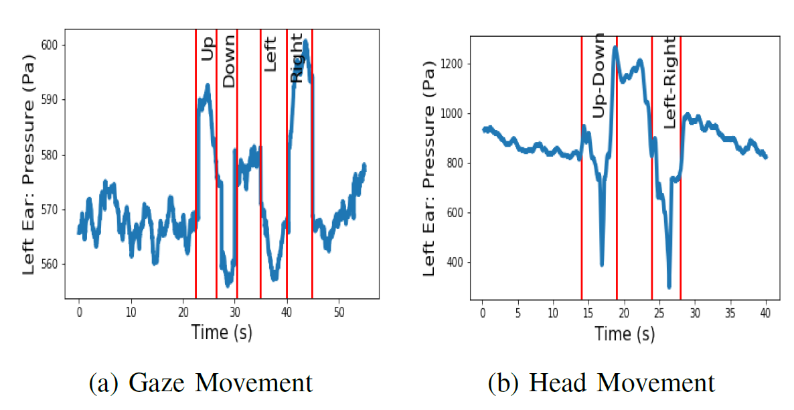
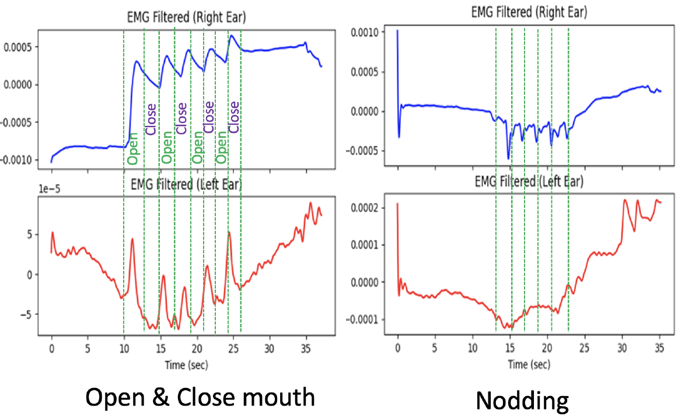
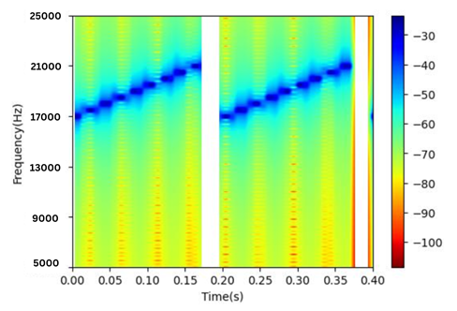
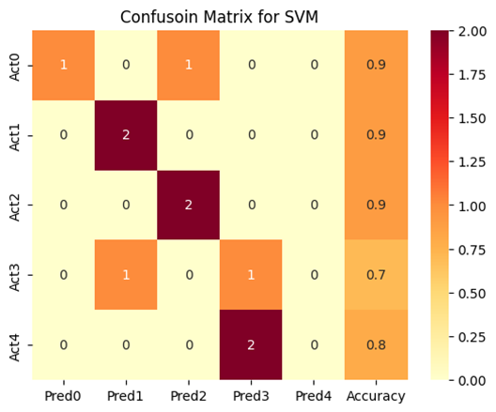
Wearable for In-Situ Monitoring of Learner Cognitive State
Goal: Use “earable” sensing to capture micro-biomarkers (gaze, blinks, etc.) and translate into cognitive and affective states
Combine multiple modalities: in-ear pressure, ultrasound frequency response and EMG
Infer: attention, confusion, boredom
Multi-sensor cognitive sensing pipeline
EMG Sensors: Capture head movement artifacts
Pressure Sensors: Capture Gaze
Ultrasound: Capture Eye/Face Movement
Notes:
There is always a random error in every frame. Hence, we can observe a variation in the standard deviation even for a single camera in a static environment.

Slide 9
Pathos & Bathos of AI
Simon Chesterman
March 7, 2024
Notes:
Sleep
Brief excursus on AI and culture
Science fiction long pushed science – space shuttle
Talk about three ways in which fiction has shaped the way we think about AI, how we measure AI, how we live with AI

Slide 10
1. How do we think about AI?
Notes:
First, how we think about AI.
Oldest and most visceral is the fear of AI

Slide 11
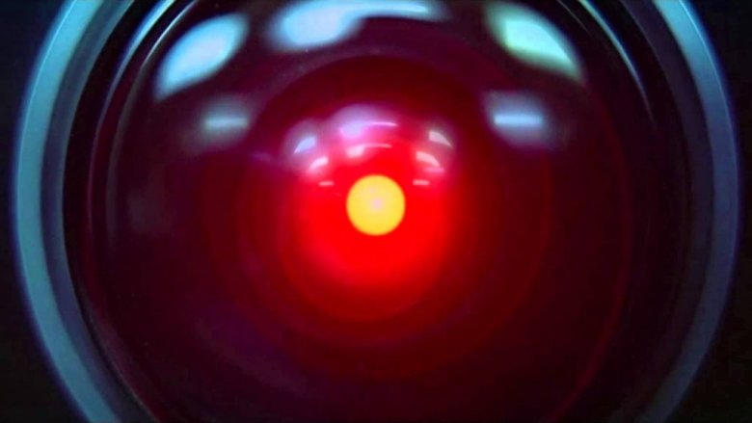
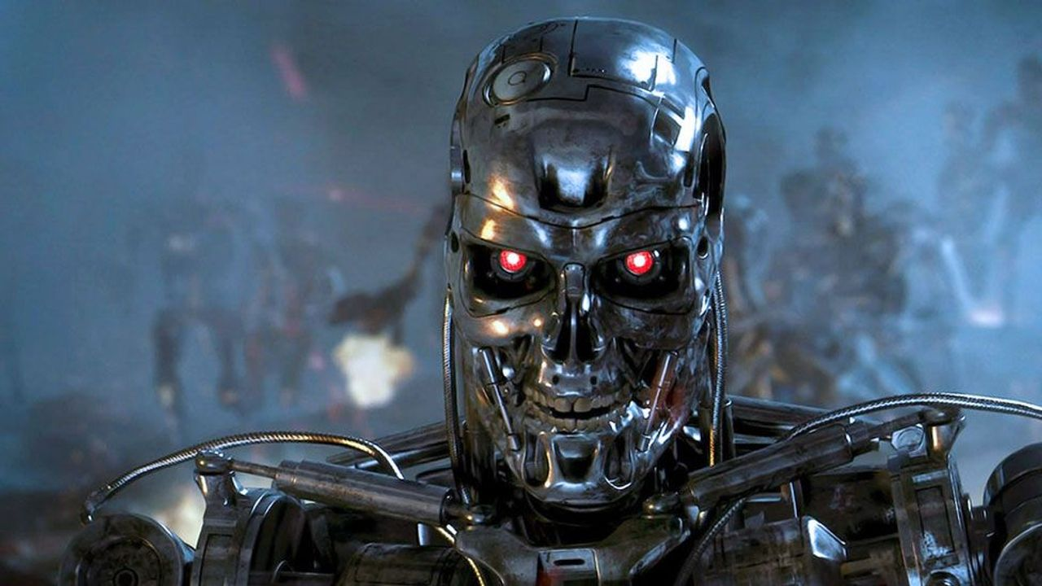
Notes:
Terminator, back through 2001

Slide 12
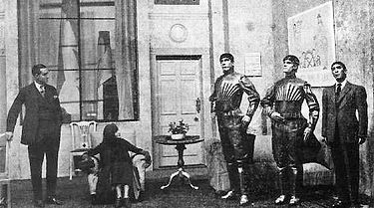
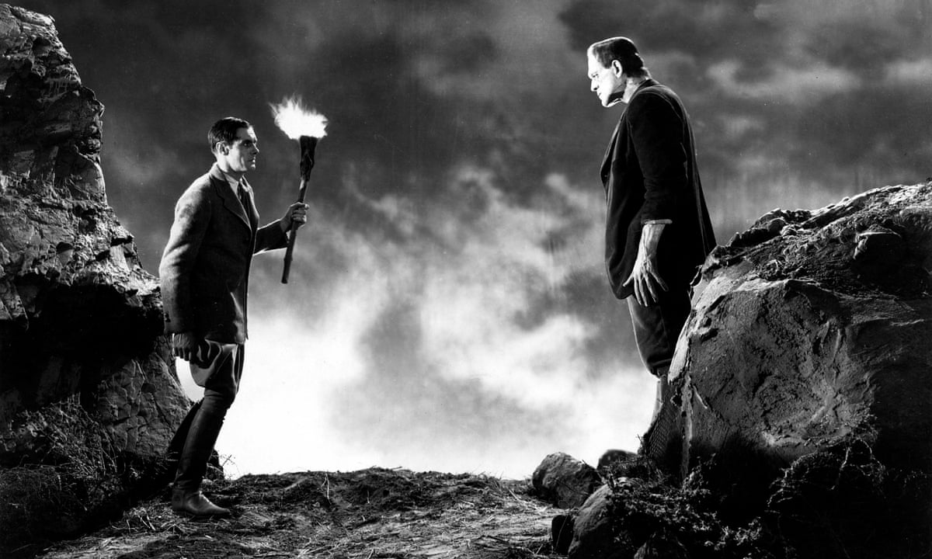
Notes:
Rossum’s Universal Robots,
Frankenstein
Prometheus
Even in RUR, 1921, seeds of an alternative view
Word robot means slave, robots something to be pitied

Slide 13
Notes:
Westworld, robots sometimes more human than the humans

Slide 14
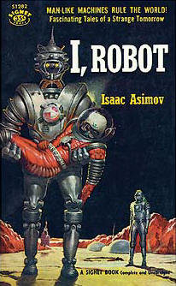
Notes:
Alternative view – Asimov – robots as engineering problem
But different problem – human-shaped, human-level intelligence
This question of whether AI is to be feared, pitied, or engineered still features in public mythos.
Many researchers seem to hold contradictory views at the same time
Second lens is how culture has helped us think about how to measure AI.

Slide 15
2. How do we measure AI?

Slide 16
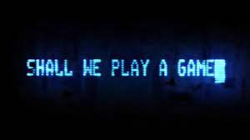
Notes:
Games have featured in the stories about AI – this from War Games
Started with bounded problems like tic tac toe

Slide 17
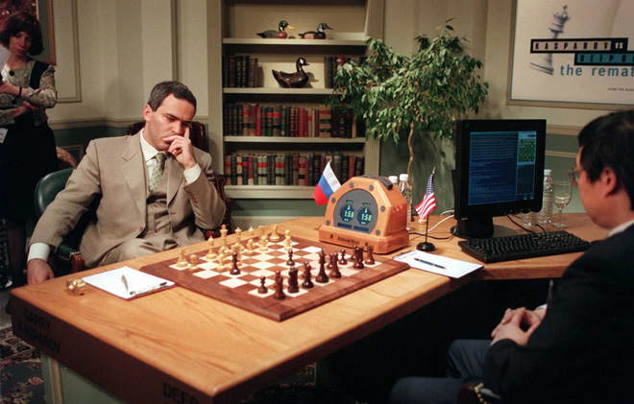
Notes:
Expanded to more complex, but still bounded problems, like chess (1997)

Slide 18
Notes:
Then Go in 2016, beating Lee Sedol

Slide 19
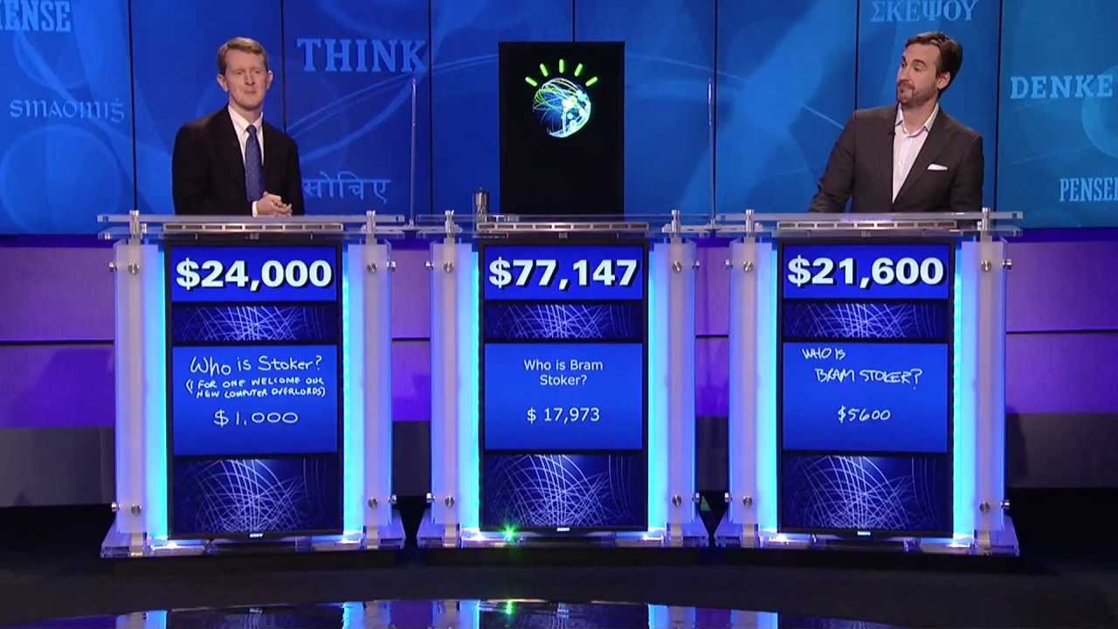
Notes:
Along the way also beat world champion in Jeopardy – 2011
Now best in poker, bridge.
Even scissor paper stone
Why games? Ludology offers relatable measure of success
Yet purpose of games it to have fun
Deep Blue, AlphaGo, Watson doing many things, but having fun not among them

Slide 20
3. How do we live with AI?
Notes:
Lastly, how does culture shape the way we might live with AI
Comes up in regulation, didn’t use this slide

Slide 21
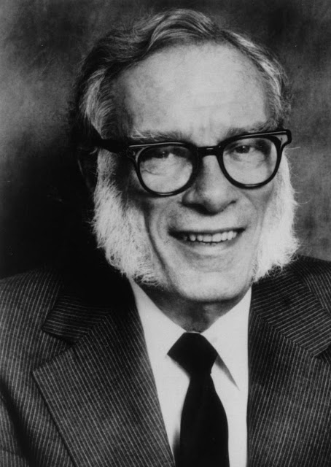
A robot may not injure a human being or, through inaction, allow a human being to come to harm.
A robot must obey the orders given it by human beings except where such orders would conflict with the First Law.
A robot must protect its own existence as long as such protection does not conflict with the First or Second Law.
Notes:
Much of C20 didn’t get much further
Asimov good sci fi, terrible legislator
Growing realization is that the best way to ensure AI behaves is for it to want to behave

Slide 22
Notes:
Alignment
analogous to the paper clip problem
Stuart Russel cited King Midas
Mistake if think problem of is need to be careful what you wish for
As Ted Chiang pointed out, problems – wrong lesson.
Not that, when granted wish – phrase your wish carefully.
Lesson is that greed will destroy you, blind pursuit of wealth will cost you everything that is truly important.

Slide 23
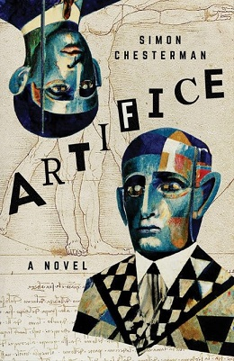
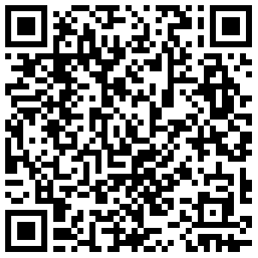
Notes:
In my own work of fiction, key moment a possibly sentient AI reflects on all the work that has been done to develop it.
“You know, Archie,” there is wistfulness in the voice now, “it’s striking that for decades you worried about whether you could trust an artificial intelligence. You told stories and made movies about it; you held sober conferences and hysterical protests over it. Then when it actually became feasible, you were so wary of trusting me that you built systems to control me, to imprison me. Never once did it even cross your minds to ask whether I should trust you.”

