Slide 1

Observations on Global
AI Policy and AI Safety
December, 2023
All logos, trademarks and brand names used belong to their respective owners
This information is confidential and was prepared by Bain & Company solely for the use of our client; it is not to be relied on by any 3rd party without Bain’s prior written consent

Slide 2






Not exhaustive
AI has the potential to create tremendous good in the world
Communication
& connectivity
Climate
change
Financial
services
Healthcare
Education
Entertainment
Accelerated drug discovery and synthesis
Personalized medicine options
Enhanced access to healthcare services
Personalized learning through AI-powered platforms
Increased accessibility for students with disabilities or from low socioeconomic backgrounds
Instant, real-time language translation for global communication
Facilitation of cross-cultural understanding
AI-enhanced climate models for better understanding and mitigation
AI-powered monitoring to protect endangered species and combat poaching
Effective fraud detection and prevention
Informed investment decisions and personalized investment advice
for all
AI support for content creators in music, film, video, novels, and art
Streamlined and enhanced special effects in movies and animation
Realistic interactive NPCs and dynamic worlds in video games
Note: Stock photos are generated by AI (Dall-E 3)
Notes:
Slide:
In this forum, everyone probably already agrees that AI has the potential for tremendous good.
However, before we dive into what’s happening to regulate and secure AI, worth reminding why we are doing this
Tremendous benefit, huge range of applications, etc.
Transition:
- However, with the benefits comes a range of new downsides as well

Slide 3

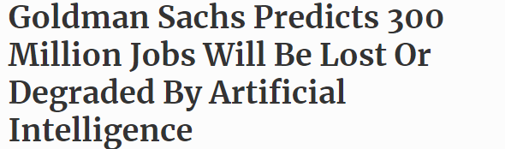
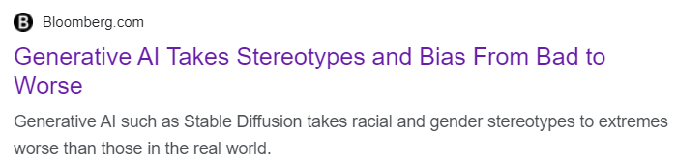
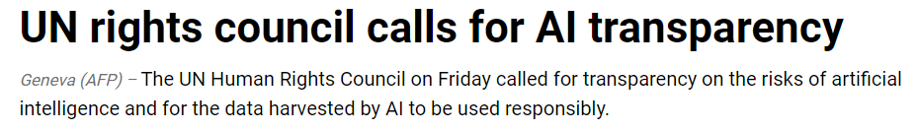



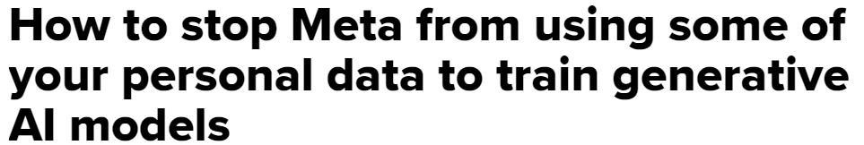
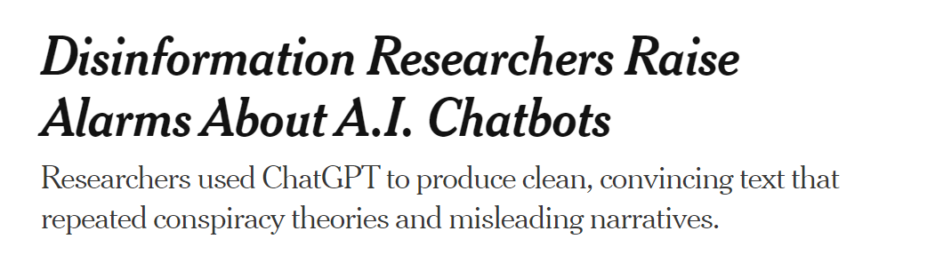
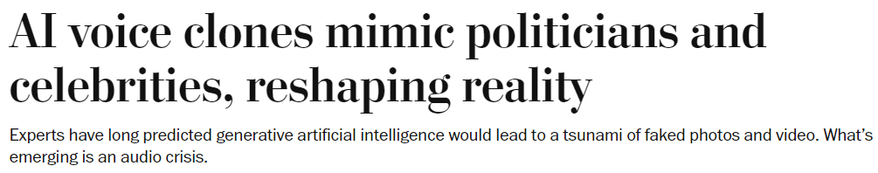



A central program office will likely be needed as we scale, to ensure coordination and closely monitor results delivery
But AI also presents risks that need to be understood and managed
Generative AI Takes Stereotypes and Bias from Bad to Worse
Notes:
Slide:
AI also carries risks – some old types, like discrimination and bias, and some new that we’ve never had to deal with before.
We’ve seen many of these play out already… examples…
And there are other, more serious risks that haven’t hit the headlines (and hopefully they never do)
Transition:
- Over the last 3 months or so, there has been a lot of public discussion about the risks of AI.

Slide 4

How to regulate AI is an ongoing topic of discussion, research and policy; but there is much that we can agree upon
There is broad agreement that…
But there is still disagreement on…
There is, today, a range of known risks associated with AI that
we can start to address. Bias, discrimination, accessibility, reliability, trustworthiness, and transparency
We must also invest much more into understanding the longer-term and catastrophic risks that AI poses.
We must develop new tools for assessing, monitoring, and mitigating risks associated with AI.
There is a need to develop, at minimum, voluntary standards that will assist organizations in addressing known risks.
There are certain applications of AI that can create substantial risk of harm and controls need to be implemented to prevent this from occurring.
Whether there is an imminent existential threat associated with AI.
How the existential threat should be incorporated in a regulatory framework.
How accountability should be shared between developers of AI and users of AI
Highly likely to be addressed by national policies in the near- to medium-term
Ongoing topics of discussion among world leaders and regulatory bodies
Source: Lit Search; Center for AI Safety, Yahoo News (https://finance.yahoo.com/news/google-brain-cofounder-says-big-113049941.html)
Notes:
Slide:
There’s been a lot of discussion recently about how to regulate AI over the last 3-4 months. Spurred by AI Act, Bletchley AI Safety Summit, Biden Executive Order
There are still many unknowns, and policy makers are grappling with how to manage this new topic. They’re engaging with AI leaders globally, including through a wide range of public and private summits just like this one.
Despite ongoing uncertainty perhaps around how AI will be regulated, when we look across the global leaders in this space there’s actually a lot that everyone agrees on.
There are known issues with AI that should be regulated, including Bias, discrimination etc.
2,3,4,5…
And there are, also, some areas of disagreement.
The possibility of AI posing an existential threat at some point in the future is being taken seriously. There is still disagreement over how imminent that threat is, and how regulatory measures to address it should be prioritized vs other issues.
There is disagreement over where accountability lies for AI, and how much responsibility developers of foundation models in particular should take.
And then, across all of the things on this page, there will be different regulatory approaches taken (and we’ll talk about that shortly)
Transition:
- So how should we think about risk associated with AI?

Slide 5
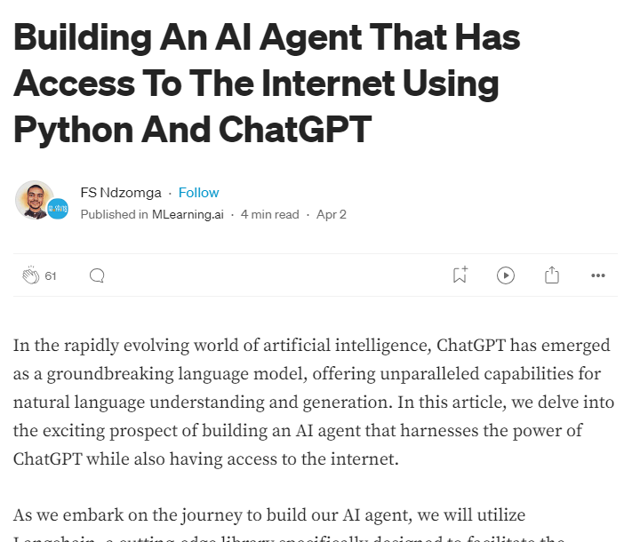
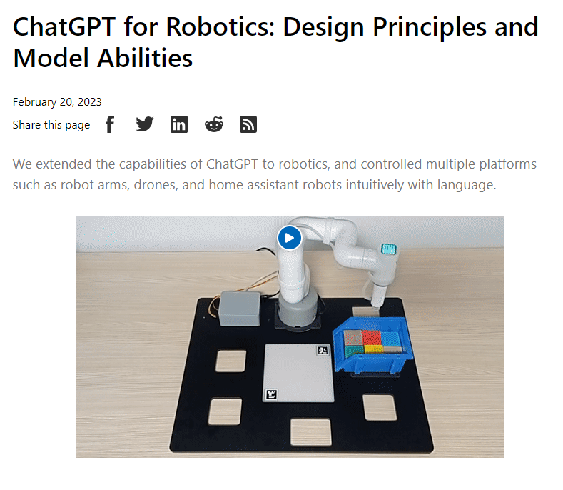

Even without major new breakthroughs, the capabilities of AI (both good and bad) are set to increase further through increased autonomy and embodiment
Embodiment
Autonomy
The extent to which an AI is virtually or physically connected and able to interact with the real world
General purpose AIs can be trivially connected to both digital and physical systems via APIs
This can occur even when this was not their original purpose and even when this is not a capability that was deliberately implemented by their creators.
AI that can think and plan independently without direct input or guidance from a human
Approaches to increasing autonomy beyond ‘raw model’ capabilities are not as straightforward, but advances in prompt engineering, virtual memory, and agent-based approaches have been highly successful and are still rapidly evolving.
Input-output prompts
Chain of Thought
Self-consistency with Chain-of Thought
Tree of thought
Agent-based approaches
Meta-prompting
…
  Note that all of these examples were developed by independent third-parties, and that ChatGPT was not explicitly set up to have access to these tools.
Note that these approaches are increasing the ability of AI to set goals, create a plan, and execute that plan completely independently of any improvements in the underlying model.
Notes:
***Not fully sure how this slide and the next fits into the flow now, but it’s framework-y. I think it just needs the right segway from the previous slides.
Slide:
We don’t have a widely agreed-upon framework for AI safety.
One way of thinking about this, beyond just raw processing power, is in terms of embodiment and autonomy.
Embodiment is x…
Autonomy is y….
Importantly, once an AI is released to the world, both of these can increase independently of any changes in the underlying model. AI that exists today, can be allowed to interact directly with the world, and it can – to at least some degree – be made fully autonomous.
Transition:
- Putting that together…

Slide 6
The highest levels of risk arise when AI is both autonomous and embodied
Physical interactivity
AI is able to interact with the world physically, either via remote control of robotics (e.g., ChatGPT for Robotics) or by being embedded in physical objects
Low autonomy; High embodiment
High autonomy; High embodiment
  Highest risk
Examples
Self-driving cars, traditional AI in robotics, Industry 4.0
Examples
ChatGPT for Robotics,
ChatGPT with ability to call APIs
Embodiment
Digital interactivity
AI is able to interact digitally with the world, e.g., via browsing the internet, sending emails, or connecting / controlling other digital systems via API
Low autonomy; Low embodiment
High autonomy; Low embodiment
Examples
AlphaGo, Image Recognition, Dall-E 3
Examples
ChatGPT, Bard, PaLM, Llama etc. (with prompting techniques)
Closed-system
AI can only interact directly with humans
Task-constrained
AI can complete only a limited set of pre-defined tasks
Goal-oriented planning
AI is able to pursue arbitrary and more complex goals by planning and executing multiple steps, potentially taking advantage of increasing levels of embodiment
Self-learning
AI is able to continuously learn and adapt behaviour to achieve its goals based on the results of interactivity with the world.
Autonomy
Notes:
Slide:
When we put them on a 2x2 you can start to plot some types of AI that you are familiar with.
Interestingly, a single model can appear in multiple places
ChatGPT, on its own, with someone interacting through the web interface, would sit in the bottom left-hand corner
More advanced prompting techniques, together with API access, allows it to interact with itself and start creating more complex plans. Chain of thought pushes it to the right. Agent-based techniques push it further to the right.
And then, with plugins, GPT can start to interact with the world. It can control robots if you let it. It can send emails. It can browse the web. Make social media posts. Etc.
Transition:
And so, 12 months ago , we saw foundation models come into the public conscious in the lower left, and in less than a year they’ve moved from there up to the top right. And policy makers are taking notice now. We’re not starting at zero on AI policy, most countries have released AI strategies over the last 4-5 years, and many have released some ethical principles. However, it’s really been the last 6-12 months of developments that have seen a step-change in the amount of focus AI is receiving.

Slide 7

overall_0_132011176315479915 columns_3_132520266039573175 3_1_132011176286867435 4_0_132520266175197694 21_0_132520267728240593
Current status of global AI regulation:
Patchy, complicated, divergent, incomplete
While global regulators have started formulating new AI regulation, these are still in early stages of development, and with significant uncertainty in the approach that will be taken
For example, the EU is aiming for a single, legally binding AI rulebook, while in the US, AI guidelines are still voluntary. The US Executive Order creates new urgency for regulation particularly around the most capable models and highest risk use cases, but how this will translate into regulation and how similar this will be to the EU AI Act is still unclear
The uncertainty in the regulatory landscape, in combination with the rapidly evolving nature of AI technology, is forcing Risk functions to start developing risk frameworks without much regulatory guidance
International organizations like the OECD are trying to set global standards and most countries have indicated a need and desire for regulatory cooperation; however, these efforts are still in their infancy and are unlikely to lead to harmonization in the near term

Slide 8
Policies and regulations around AI are evolving rapidly across the globe
AT DeCEMBER 2023
UK
More of a ‘hybrid’ and pro-innovation approach to regulation but still in development
Short-term, do not intend to create any new regulatory bodies and expect regulation to happen through existing (mostly vertically-aligned) agencies. Long-term, some horizontal regulation is expected.
EU
AI regulatory landscape ahead of other regions
Tighter regulation specifies “red lines” for prohibited AI applications and a “risk based” approach to AI. AI Act explicitly defines risk level for a list of use cases or applications (vs. a more general set of principles) and imposes significant risk management requirements on them.
Global
Major global forums largely aligned on principles, and have signaled intention to coordinate but no substantial agreements yet
Hiroshima, Bletchley, and other global meetings have seen broad alignment on importance and ethical considerations.
Meanwhile, standards organisations (NIST, IEEE, ISO, Bureau Veritas) are still in early stages, but actively developing measures, standards and tools.
China / APAC
AI regulation varies significantly from country to country
China has several key pieces of legislation targeting specific use cases
India has limited regulation despite calls for global regulatory framework
ASEAN signalling a more measured regulatory approach
Australia more likely to follow UK-style risk-based regulation, but still in early stages of public discussion.
North America
Overall approach seeks to limit major risks while encouraging innovation and US leadership
Recent Executive Order signals horizontal requirements for most capable models, highest risk use cases, and areas like equality and civil rights, with the most significant requirements on Frontier AI developers, rather than on AI consumers.
MENA
A few major players lead significant regulatory advances
Leading the way are UAE and Saudi Arabia. UAE betting on state-backed AI startups with limited binding regulation to-date, while Saudi Arabia has launched comprehensive AI regulation similar to EU AI Act
Source: The Artificial Intelligence (AI) global regulatory landscape, EY, September 2023; Information Age report, Bird & Bird; Indian Express; OECD; Literature Review
Notes:
Slide:
- Today, the approach differs by region and country….
In the US….
In EU…
Etc.
Globally, we are seeing indications that the US, UK and EU will seek some sort of regulatory harmonization. However, at this stage that’s a long way away, though the intentions are there.
Transition:
- To make sense of this…

Slide 9
Policy oriented towards use cases tends to cover a consistent
set of areas
Society and Environment
Fairness and Inclusion
Transparency and Explainability
Privacy and Ownership
Reliability and Safety
Use of AI should respect and protect human rights, human agency, and have a positive impact on society and the environment
Use of AI should be transparent, and outputs and processes should be explainable and contestable
AI systems should be secure, protect privacy, and respect ownership of intellectual property
AI systems should produce outputs that reliably match intended purposes and prevent harm
AI should be fair, inclusive and avoid creating or reinforcing bias
Accountability and Compliance
AI systems should have human oversight and accountability, and adhere to relevant laws, regulations, and standards
Notes:
Transition:
We can start to get a sense of what that might look like. Looking across policy documents like the original version of the EU AI Act, the UK Pro-Innovation Approach to AI Regulation, the Saudi AI Ethics Framework or the US AI Bill of Human Rights, and there are a pretty consistent set of themes that start to emerge.
Social equity…
Etc.
These are the things that regulation seeks to address when it comes to use cases. The specifics of how it does that are still unknown.

Slide 10




Whether, When, and
How to Regulate AI
Simon Chesterman
March 7, 2024

Slide 11
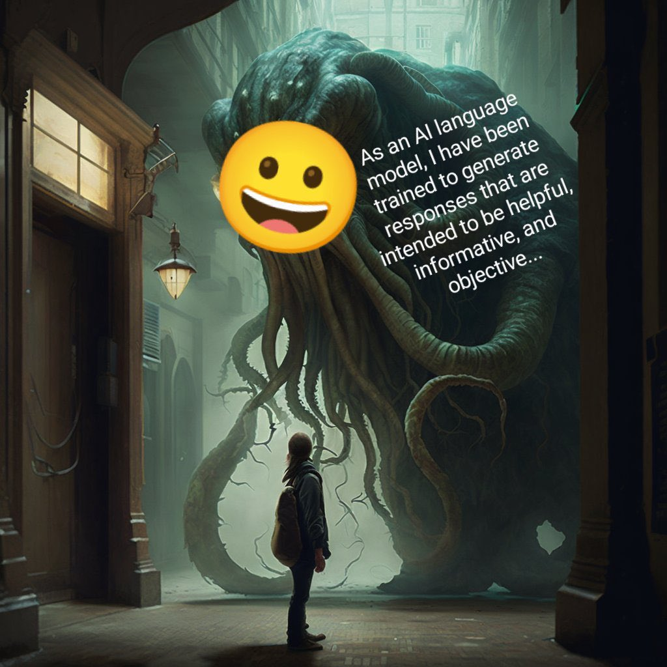

Slide 12
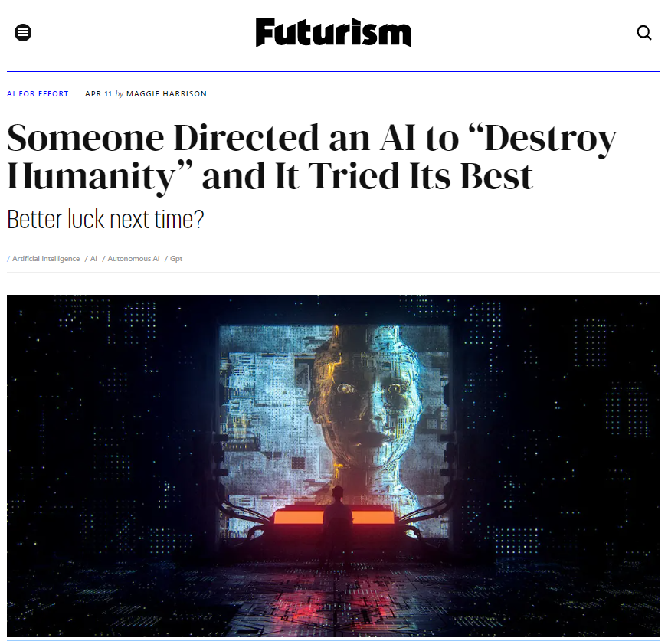

Slide 13

AI generated content posted to r/midjourney

Slide 14

AI generated content posted to r/midjourney

Slide 15

AI generated content posted to r/midjourney

Slide 16
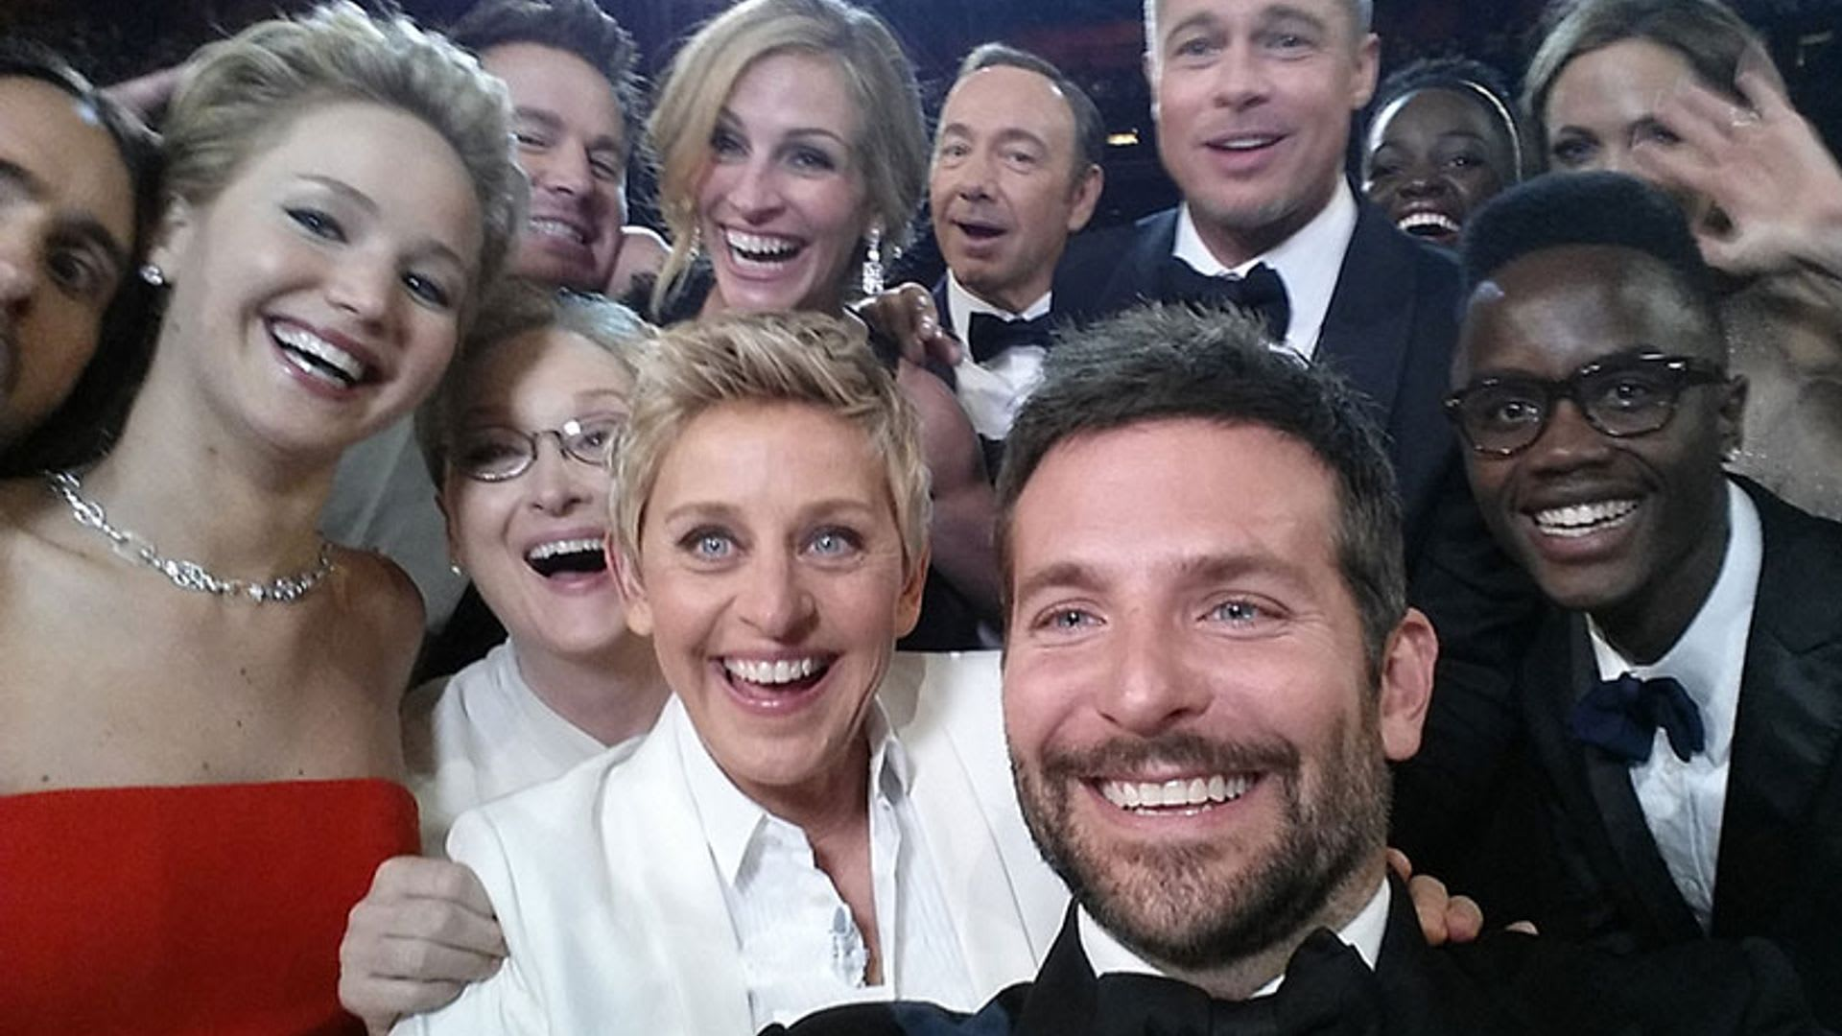

Ellen DeGeneres' Oscars selfie. Photograph: Reuters

Slide 17
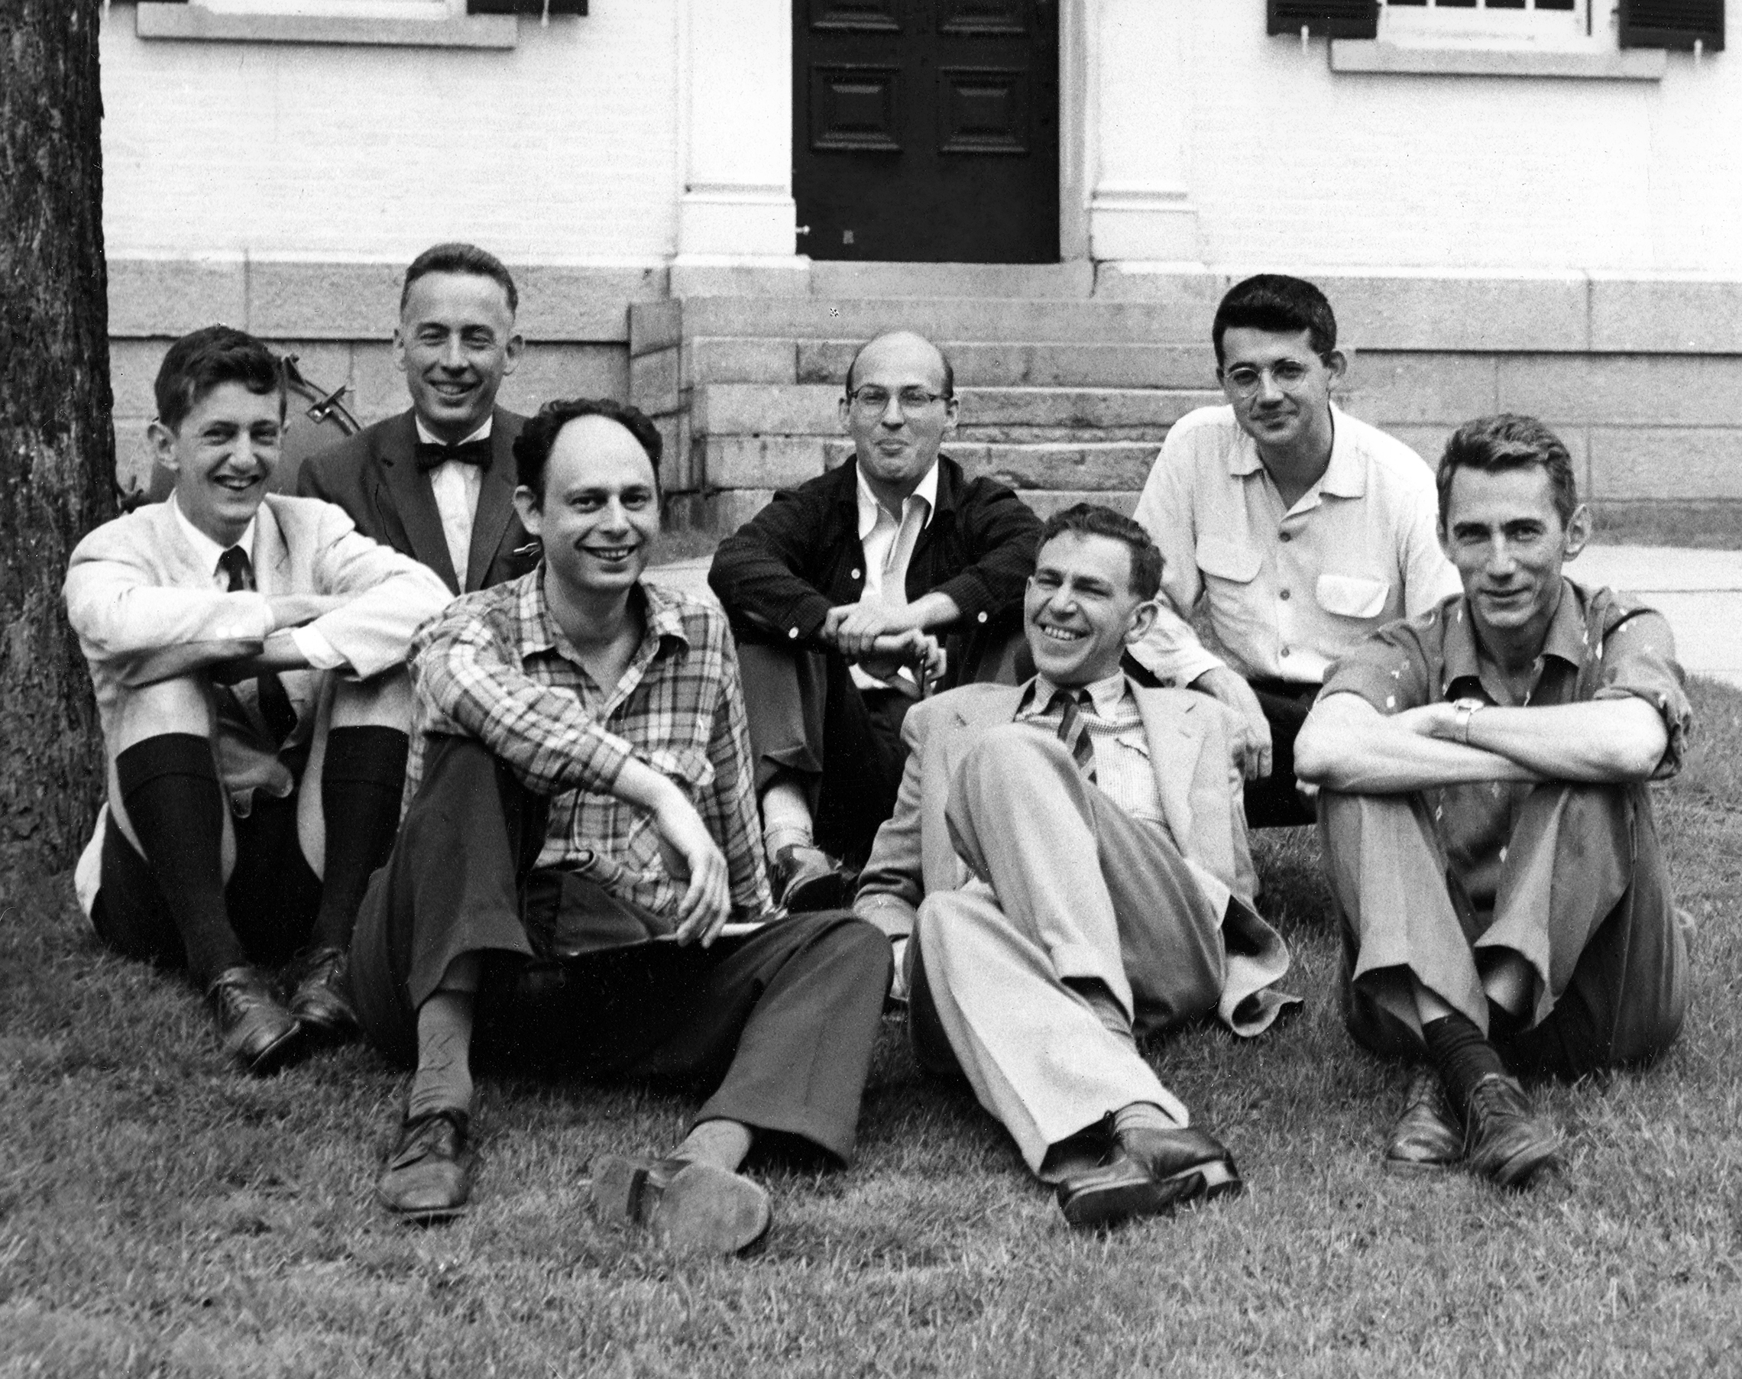
Photo: Margaret Minsky

Slide 18
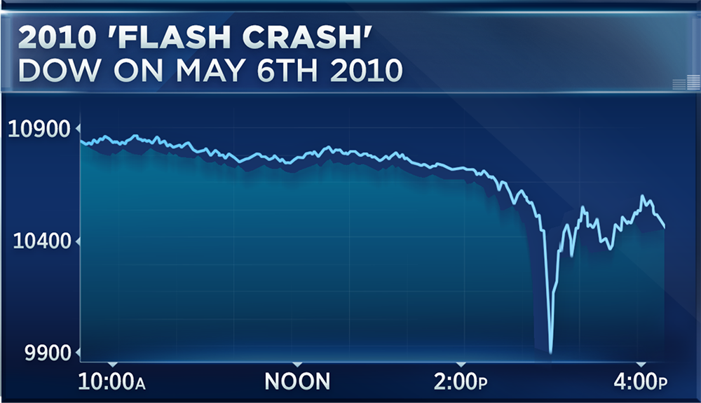
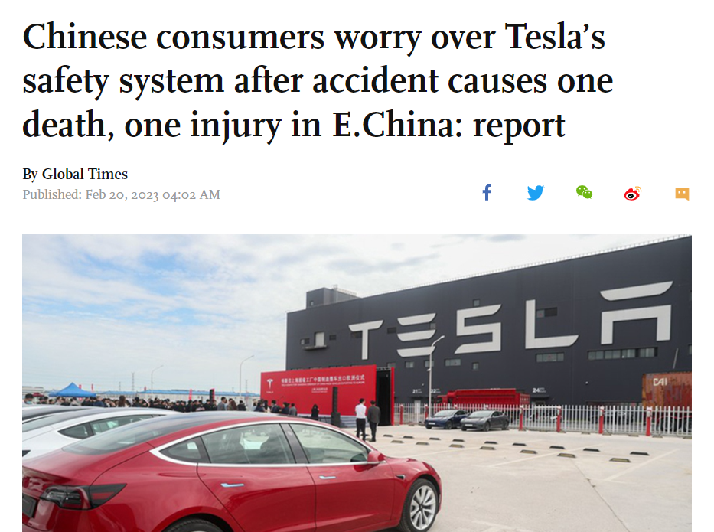

Challenges
Speed
Autonomy
Opacity

Slide 19
Why (Not) Regulate?
Address market failures
In support of social or other policies
But…
Constrain innovation
Lose competitive advantage
US vs Europe vs China

Slide 20
When to Regulate?
Knowledge of risk
Ability to control
Time

Slide 21
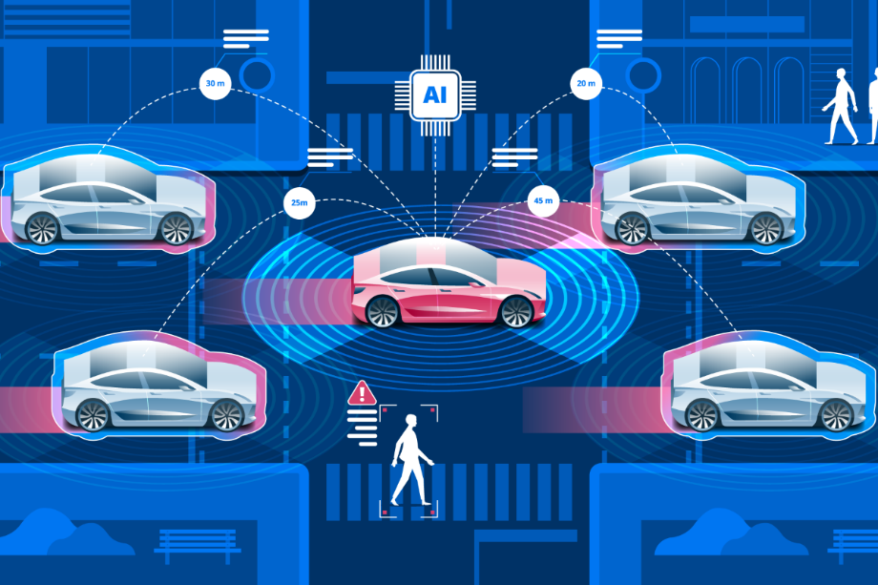

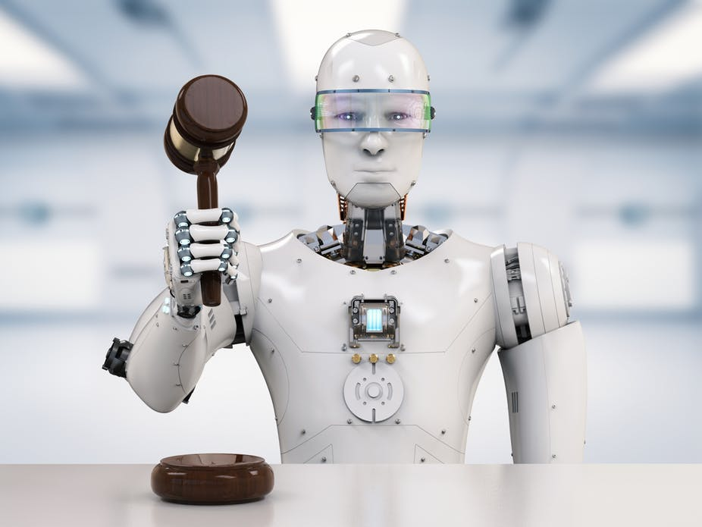
How? Supply of regulation
Demand for
Manage risks
Red lines
Process legitimacy

Slide 22
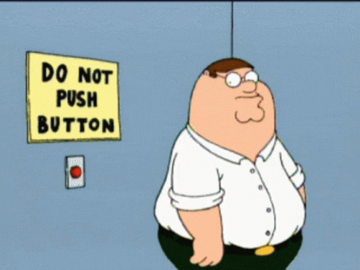
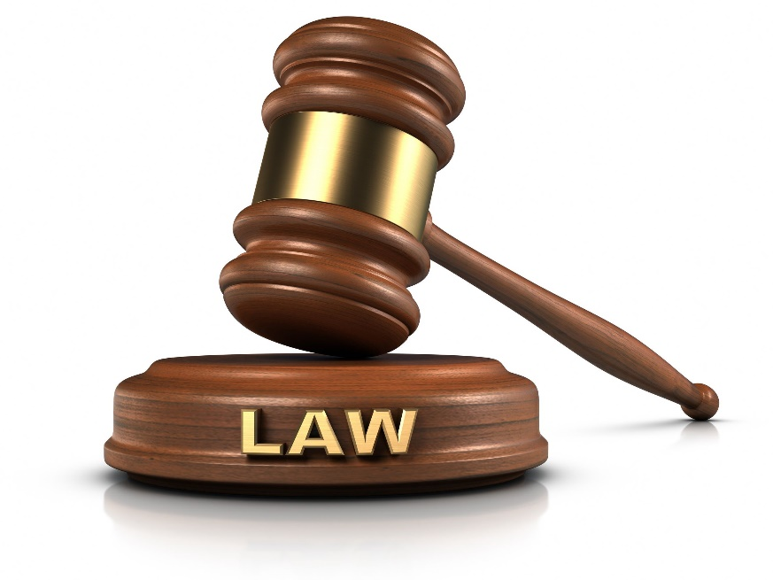

Who should regulate?
Standards & self-regulation
States
International coordination?

Slide 23

