Slide 1
AI and the Future of Work:
Creating Human-Computer Superminds
Thomas W. Malone
MIT Center for Collective Intelligence
Copyright 2024 Thomas W. Malone. All Rights Reserved.
Notes:
I have two messages for you today about how to think about AI and the future of work.
The first is…

Slide 2
or
and
Notes:
… that we should be thinking less about people or computers and more about people and computers--less about how many jobs computers are going to take away from people, and more about what people and computers can do together that could never be done before.
The second message is a way of thinking about these human-computer combinations…

Slide 3
Superminds –
Groups of individuals acting together in ways that seem intelligent
Notes:
That is, that they are all examples of what I call superminds which I define as…
groups of individuals acting together in ways that seem intelligent.
Now by this very broad definition, superminds are all around us all the time,
For example,
companies,
governments,
labor markets,
scientific communities,
the editors of Wikipedia, and
the global economy

Slide 4
Notes:
companies,

Slide 5
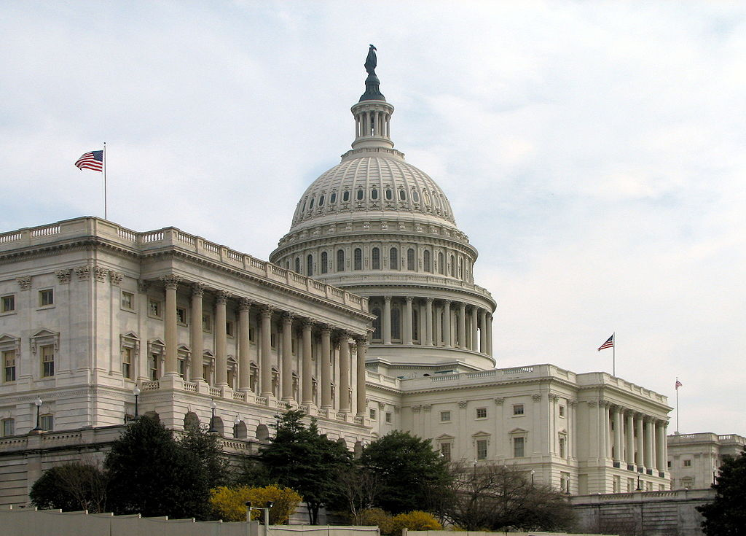
Notes:
governments,

Slide 6
Notes:
labor markets,

Slide 7
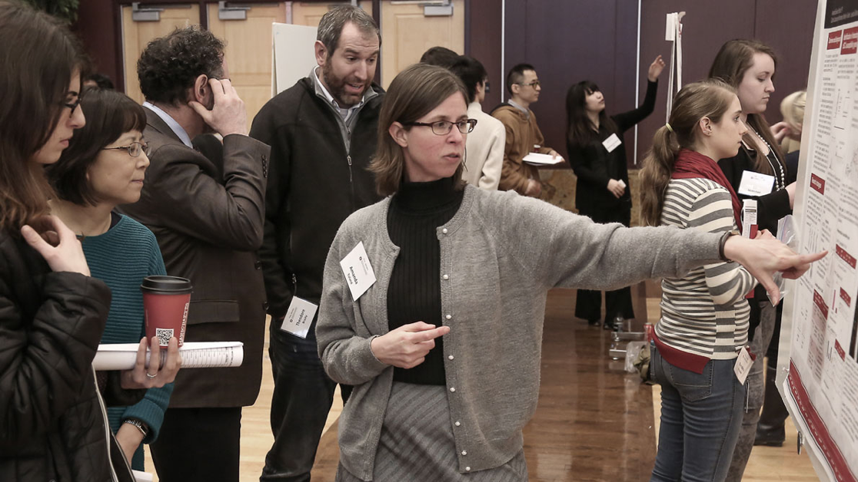
Notes:
scientific communities,

Slide 8
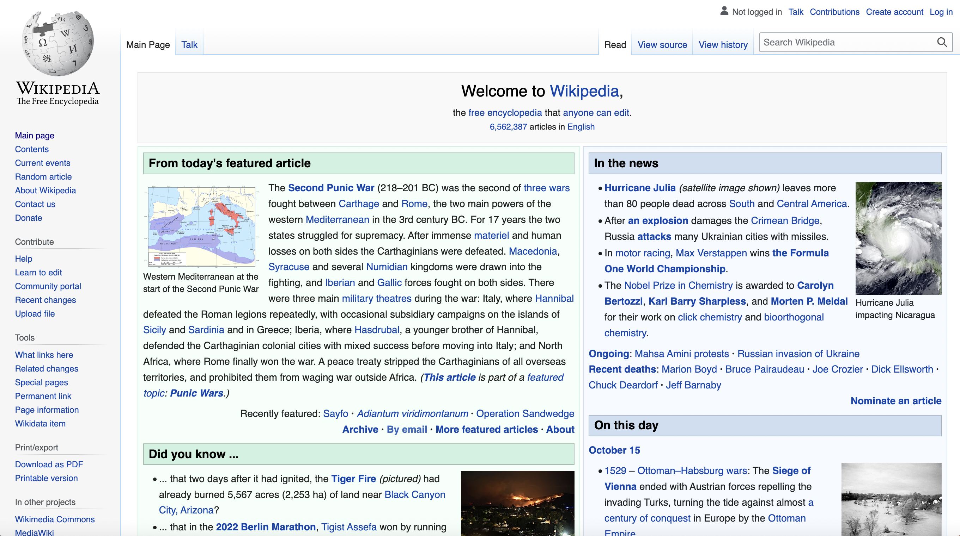
Notes:
the editors of Wikipedia, and

Slide 9
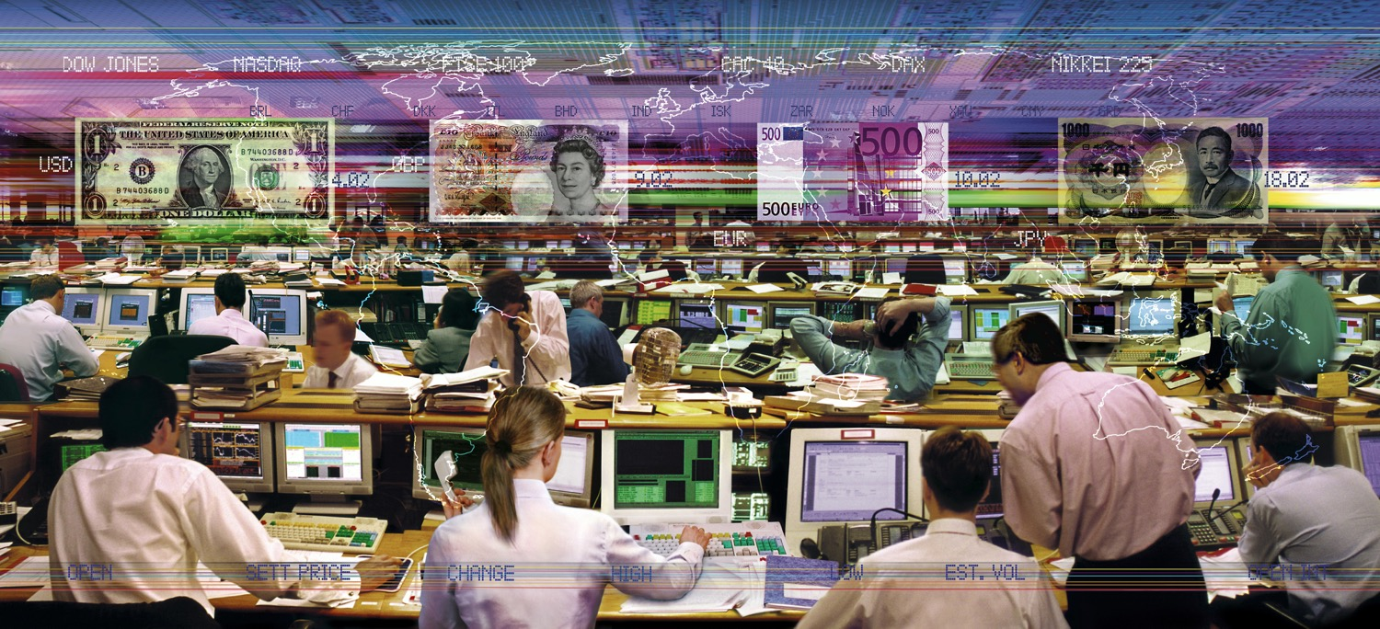
Notes:
the global economy
… are all examples of groups of people acting together in ways that—at least sometimes—seem intelligent.

Slide 10
Notes:
Now, many of these superminds already include computers, and computers can make much smarter superminds possible

Slide 11
ChatGPT
Notes:
Think of ChatGPT, for instance. It’s AI technology is able to carry on intelligent conversations about a vast range of topics, but this system wouldn’t have been possible without
the huge amount of human-generated content on the Internet that was used to train it, and
the humans who trained it further by giving feedback about which of its responses were good and which weren’t.
Now computers don’t always make superminds smarter…

Slide 12
Notes:
… like when fake news influences voters in a democracy.
But I think if we use them wisely, these computers have the potential to help us create human-computer superminds that are smarter than anything we’ve ever seen before.
Here’s one way of framing the core question about how to do this…

Slide 13
How can people and computers
be connected so that
— together—
they act more intelligently
than any person, group, or computer
has ever done before?
Notes:
Of course, that’s a big question, and nobody knows all the answers to this question.
But I want to talk today about three ways AI--especially generative AI--can help answer this question…

Slide 14
Generative AI can …
help less skilled people do jobs they would never previously have been able to do

Slide 15
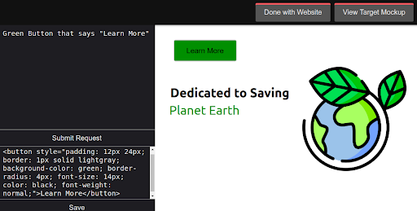
Generating software
Recreate a web page from an image of the page
Notes:
In one project we did in our laboratory, we created a gen-AI based software tool to help people replicate the code to generate a web page from looking at an image of the page and describing its elements in English

Slide 16
Results
Human programmers do the task
27% faster with this tool than without it
Human non-programmers do the task
as fast as programmers
as well as programmers
less expensively than programmers
Source: Campero, A., Vaccaro, M., Song, J., Wen, H., Almaatouq, A., & Malone, T. W. A Test for Evaluating Performance in Human-Computer Systems, https://arxiv.org/abs/2206.12390.

Slide 17
Generative AI can …
Be used in many ways besides just as tools or assistants for people
Notes:
A second possibility is that…

Slide 18
Supermind Design
Basic design moves
Zoom in – What are the parts of the problem?
Zoom out – What is the bigger picture in which the problem fits?
Analogize – What are analogies for this problem?
Supermind design moves
Groupify – How can different kinds of groups help solve the problem?
Cognify – How can the different cognitive processes be done?
Technify – How can technology help solve the problem?
…
Notes:
To help people imagine such possibilities more systematically, we’ve developed a methodology—called Supermind Design--that lets you ask yourself a set of questions to spark innovative ideas you might not otherwise have thought of.
For example, one part of the methodology is what we call the call the “Groupify” move which involves thinking systematically about how to use different kinds of superminds…

Slide 19
Supermind types
Hierarchies
Democracies
Markets
Communities
Ecosystems
Copyright 2019 Thomas W. Malone. All Rights Reserved.
Notes:
…like hierarchies, democracies, markets, and communities.
For instance, here are some unusual ideas for how generative AI could be used in different kinds of groups

Slide 20
Supermind types
Hierarchies
Democracies
Markets
Communities
Ecosystems
Generative AI bots as gig workers on the web
Copyright 2019 Thomas W. Malone. All Rights Reserved.

Slide 21
Supermind types
Hierarchies
Democracies
Markets
Communities
Ecosystems
Groups of people and generative AI systems were jointly editing documents (like on Wikipedia)
Copyright 2019 Thomas W. Malone. All Rights Reserved.

Slide 22
Generative AI can …
Help people be creative in many interesting ways
Notes:
The last possibility I want to talk about is how, contrary to what you might think…

Slide 23
Early stage product design
Produce inspirational images for designing a “chair for children”
Notes:
For example, in another project we did in our lab, we used a combination of two different Gen AI tools to help with the early stages of product design by:
First taking a design problem stated in English (like “design a chair for children”) and using one system to generate verbal descriptions of a bunch of diverse ideas related to this problem
Then using another system to generate images for each of these ideas.
Finallly, letting people pick what they thought were the best images to stimulate further design work

Slide 24
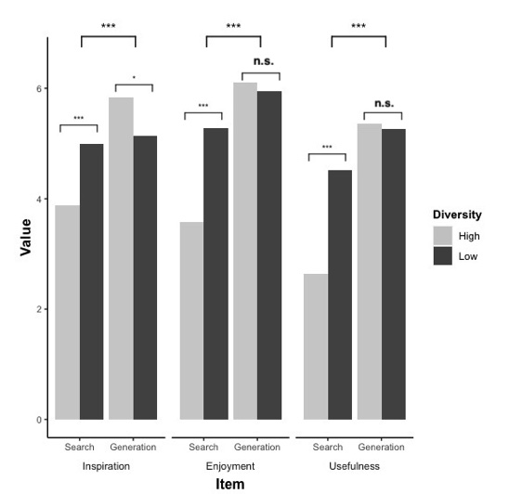
Results
Users found this significantly more
inspiring, enjoyable, and useful
compared to using traditional image search (Pinterest)
Source: Cai, A., Rick, S. R., ,Heyman, J., Zhang, Y., Filipowicz, A., Kong, M., Klenk, M., Malone, T., DesignAID: Using generative AI and semantic diversity for design inspiration, ACM Collective Intelligence Conference 2023, November 6 – 9, 2023, Delft, Netherlands.

Slide 25
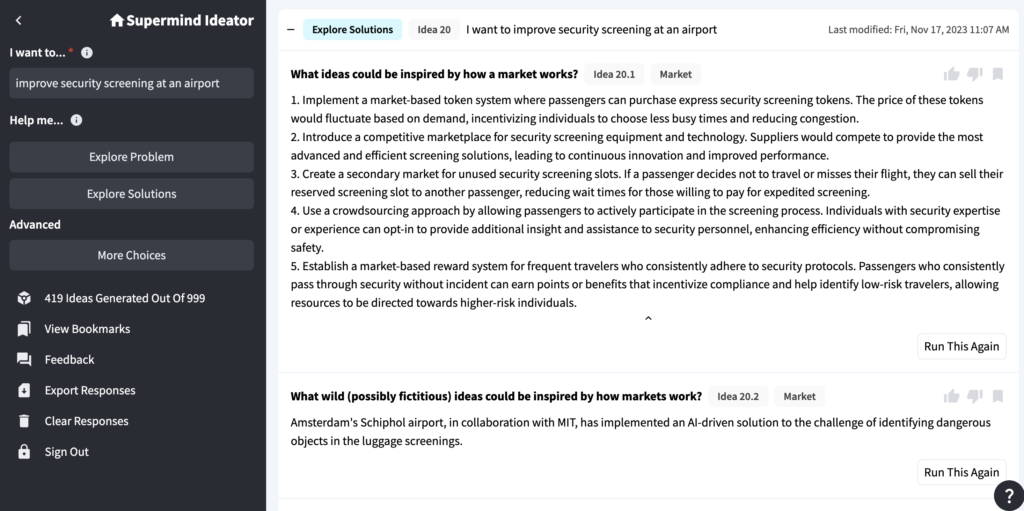
Supermind Ideator
Rick, S. R., Giacomelli, G., Wen, H., Laubacher, R. J., Taubenslag, N., Heyman, J. L., Knicker, M. S., Jeddi, Y., Maier,H., Dwyer, S., Ragupath, P., & Malone, T. W. Supermind Ideator: Exploring generative AI to support creative problem-solving. arXiv:2311.01937, November 2023.
Notes:
As another example of helping people be creative, we’ve even developed in our lab a system, called Supermind Ideator, that uses generative AI answer the automatically answer the Supermind Design questions for any problem the user types in, in ways that can, in turn, spark people to have even more ideas
And we’re now applying both the Supermind Design methodology and the Supermind Ideator with partner organizations here in Singapore, including
Changi Airport and
the National Robotics Program

Slide 26
Conclusions
AI should not just replace people; it should help people do things that were never possible before.
We will need to learn how to work productively with a new “species” of intelligence on our planet
Notes:
Share our planet with a new form of intelligence that is smarter than we are in some ways—like arithmetic—but not as smart in other ways—like certain kinds of social skills.
I think that’s the future of work.

Slide 27
Human-AI Team in Work: Observations from a Delivery Platform
WANG Hai
Ph.D. in Operations Research, MIT
Associate Professor, School of Computing and Information Systems
Singapore Management University
Visiting Professor, Heinz College of Information Systems & Public Policy
Carnegie Mellon University
http://wang-hai.net/

Slide 28
Human-AI Team in Platform Economy
Platform Economy
Ride-hailing & food delivery
AI (algorithms) for platform operations
Human freelancers & workers
Human Compliance to AI (or not?)
AI (algorithm) recommends route
Human (drivers) choose individual route
Do drivers follow the AI recommendation?
What’s the corresponding performance of drivers?
How to improve the systems?

Slide 29
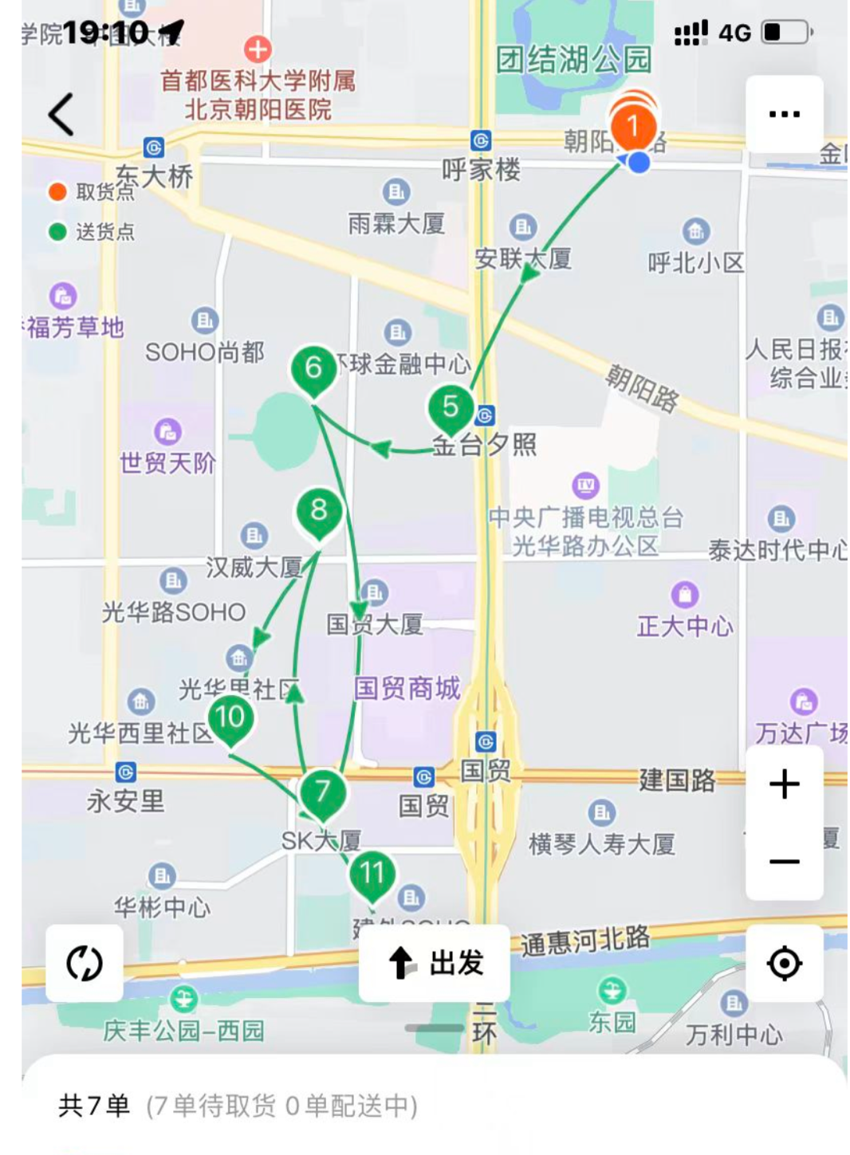
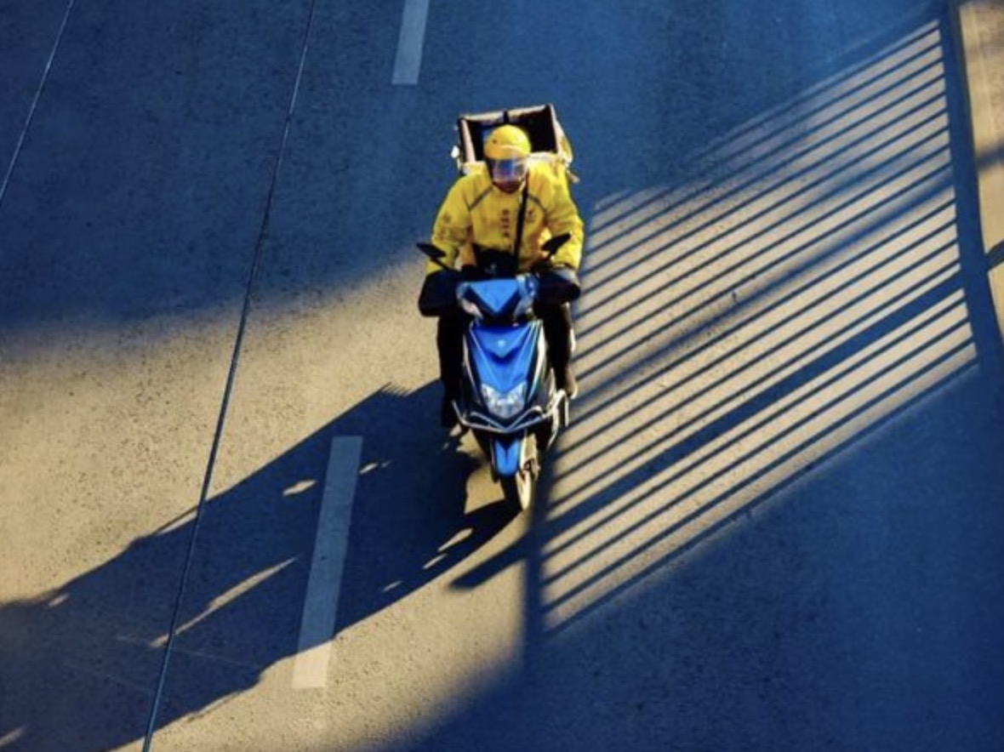
Observations from a Platform
AI vs. Human
AI algorithm: Minimize total distance (system)
Human drivers: Minimize total distance + order late rate (individual)
Empirical Observations
Operational data from a platform
X: characteristics of orders & drivers
Y: quantified difference between actual & recommended routes
Rookie drivers: follow AI recommendation; small route difference; higher order late rate
Experienced drivers: autonomous routing; large route difference; lower order late rate

Slide 30
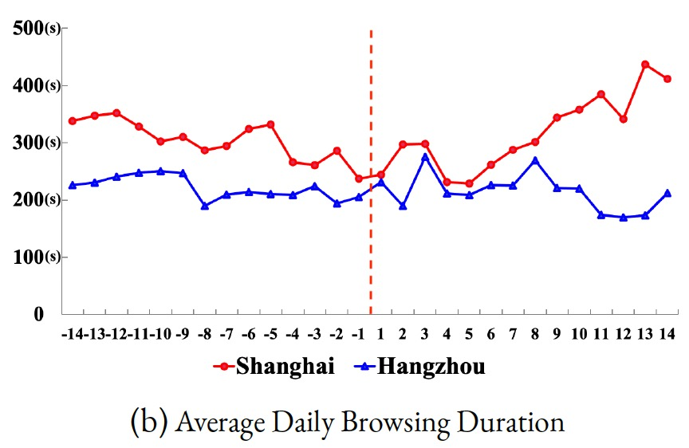
What We Try and How it Works?
Incorporate Human Concerns in AI Algorithms
Control: Minimize total distance
Experiment: Minimize total distance + late rate
Rookie drivers: unchanged behavior
Experienced drivers: more & longer map-browse
Experienced drivers: reduced route difference
AI moves closer to human
Human also moves closer to AI
Human-AI Collaboration in the Future of Work
AI should consider human goals
Higher human compliance
Better system performance

